Slide 1
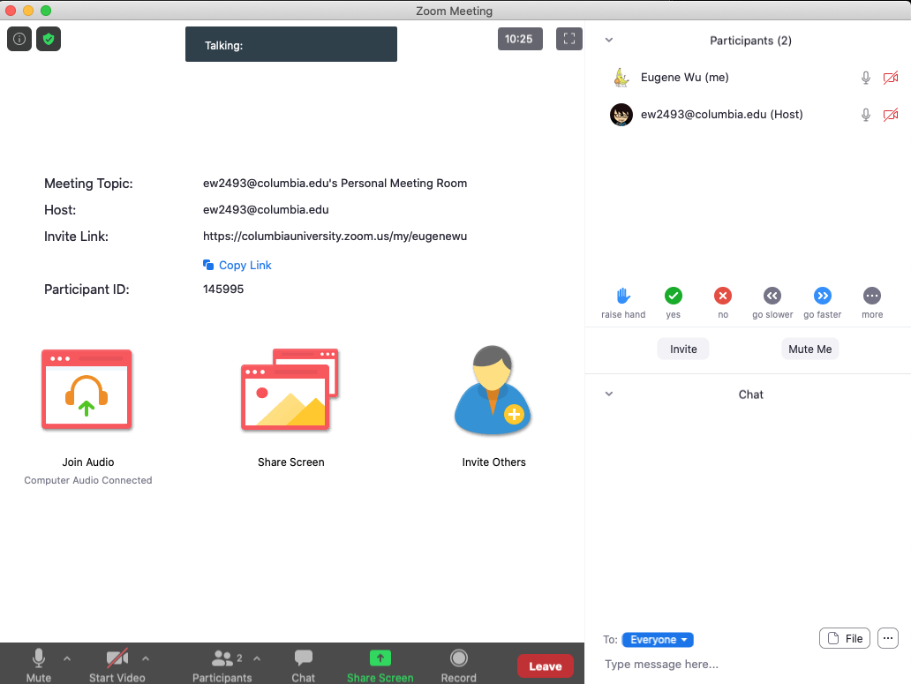
Setup Zoom to Look Like This
Participants
Chat

Slide 2
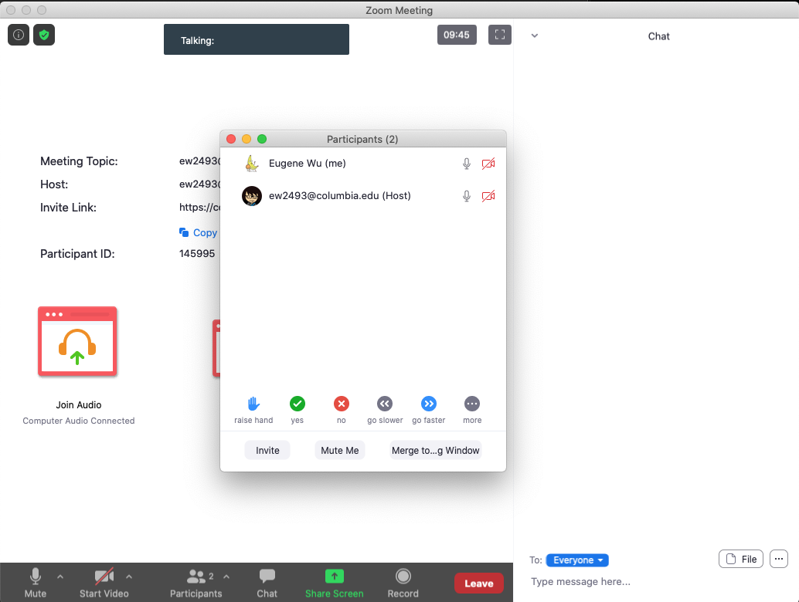

Using Zoom
Open Chat & Participants
Merge Window
Click the green check in the participants list when done
2
1

Slide 3
Participation Protocol
Raise Hand to speak
Share thoughts and questions in chat
Thank/applaud colleagues that speak up/present

Slide 4
Is it possible for 1 + 1 = 3??? If so, when?
Open chat and share what you think
Chat

Slide 5
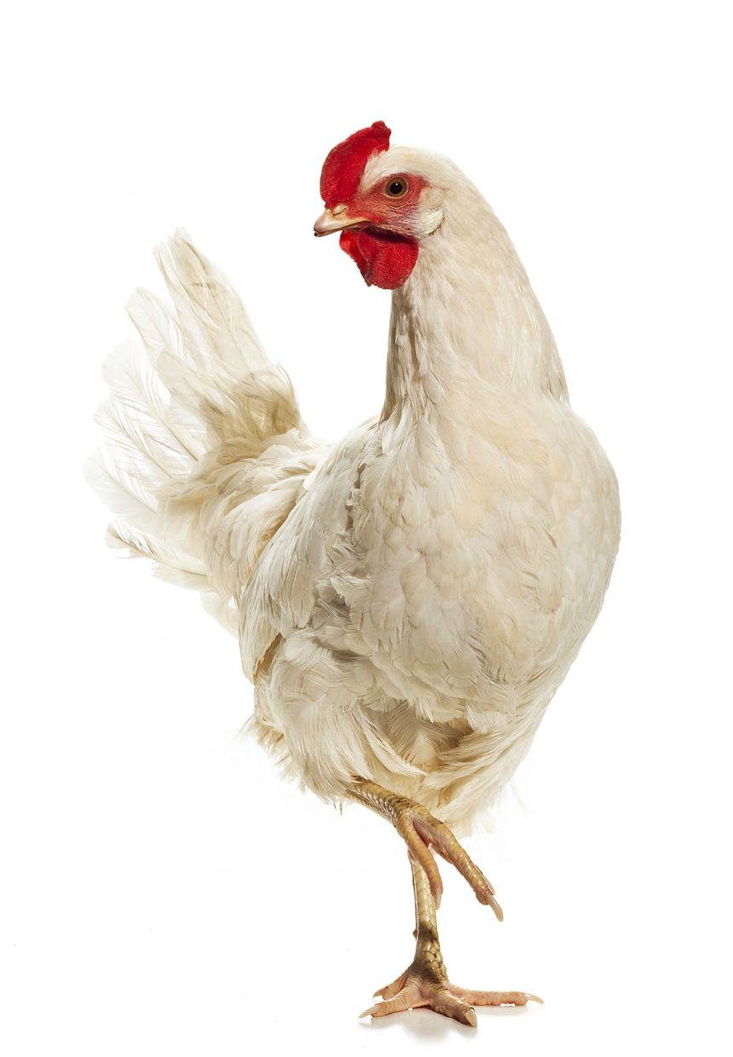
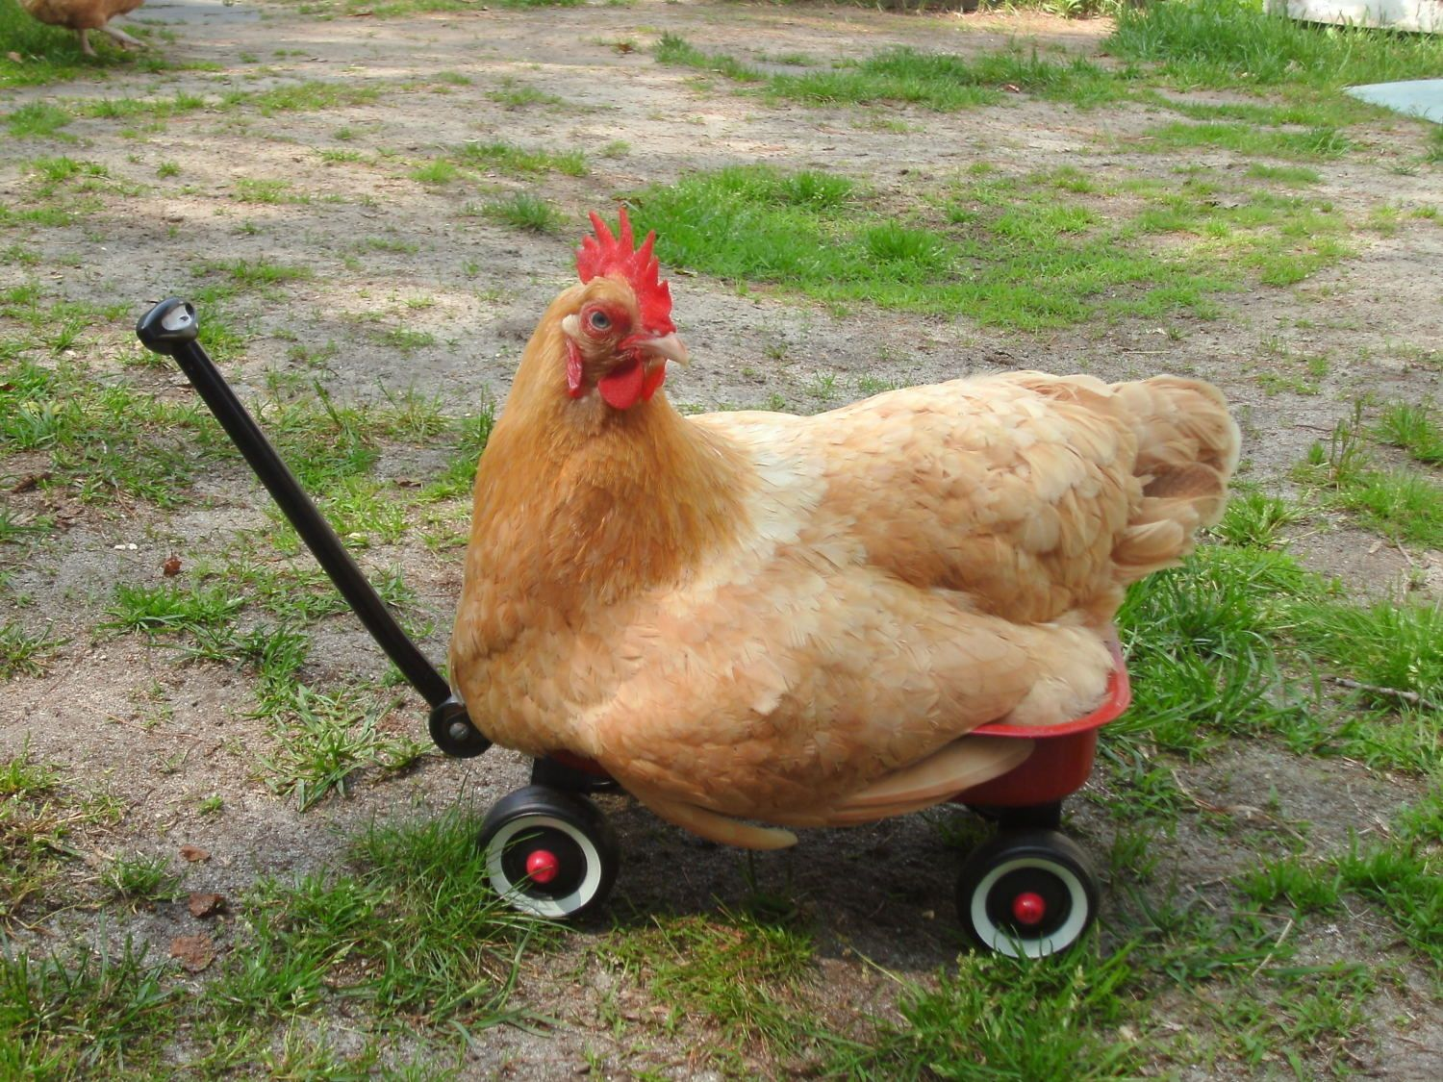
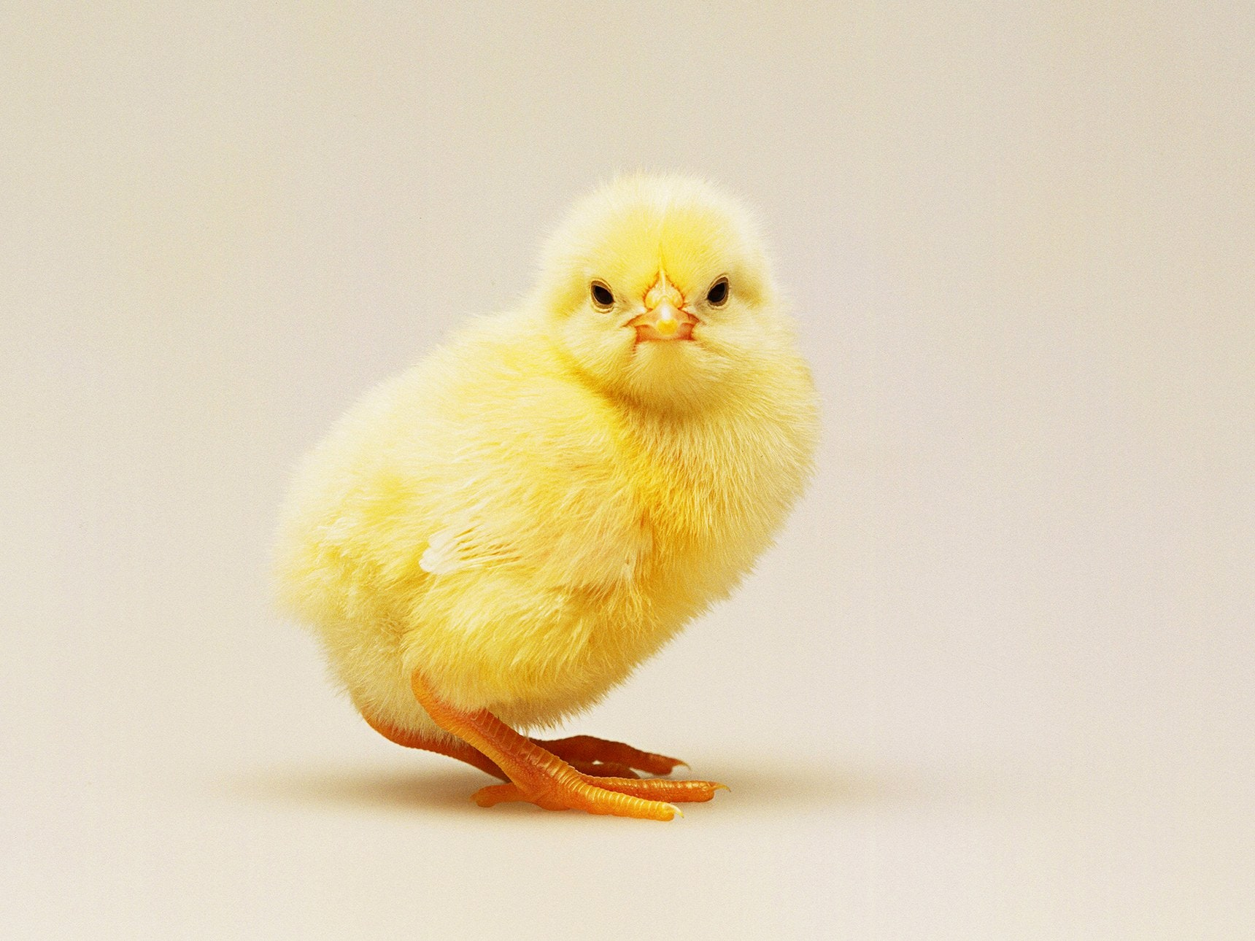
+

Slide 6
Participation Protocol
Raise Hand to speak
Share thoughts and questions in chat
Thank/applaud colleagues that speak up/present
I may ask individuals to share thoughts on the readings

Slide 7
Using Zoom
Give a green check when done

Slide 8
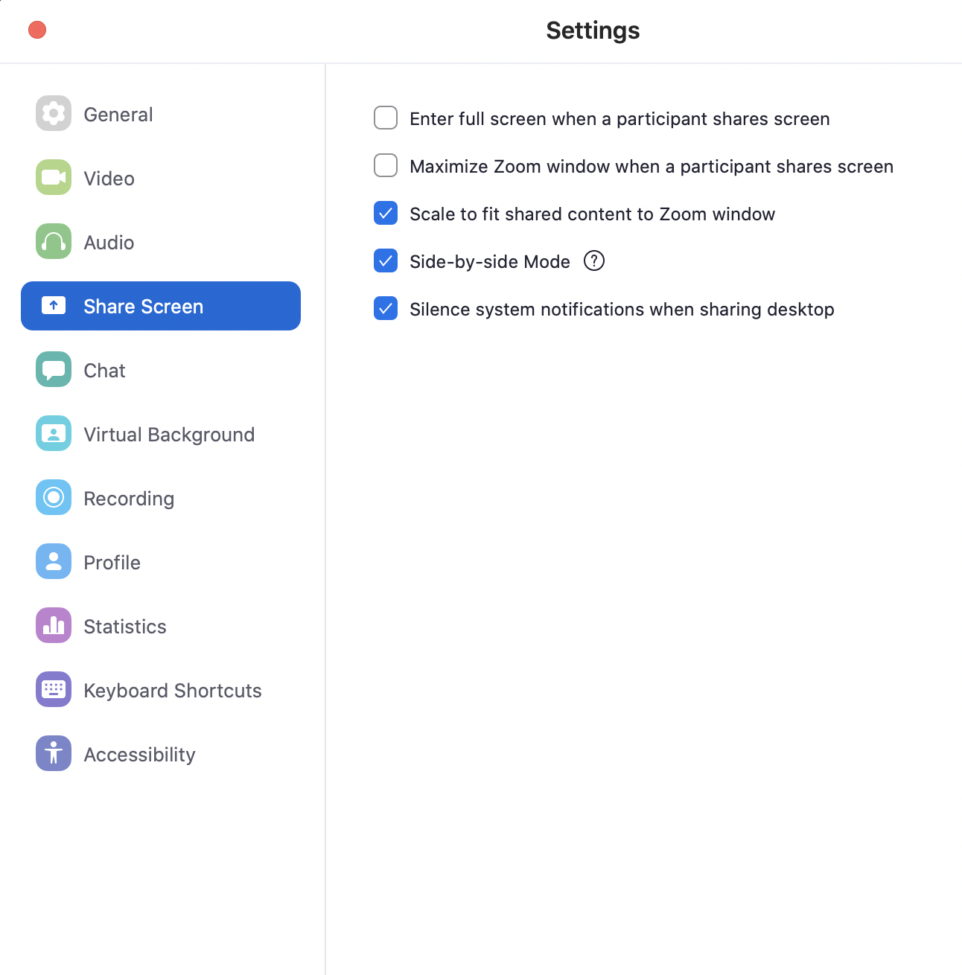
Using Zoom
Give a green check when done
Uncheck this

Slide 9
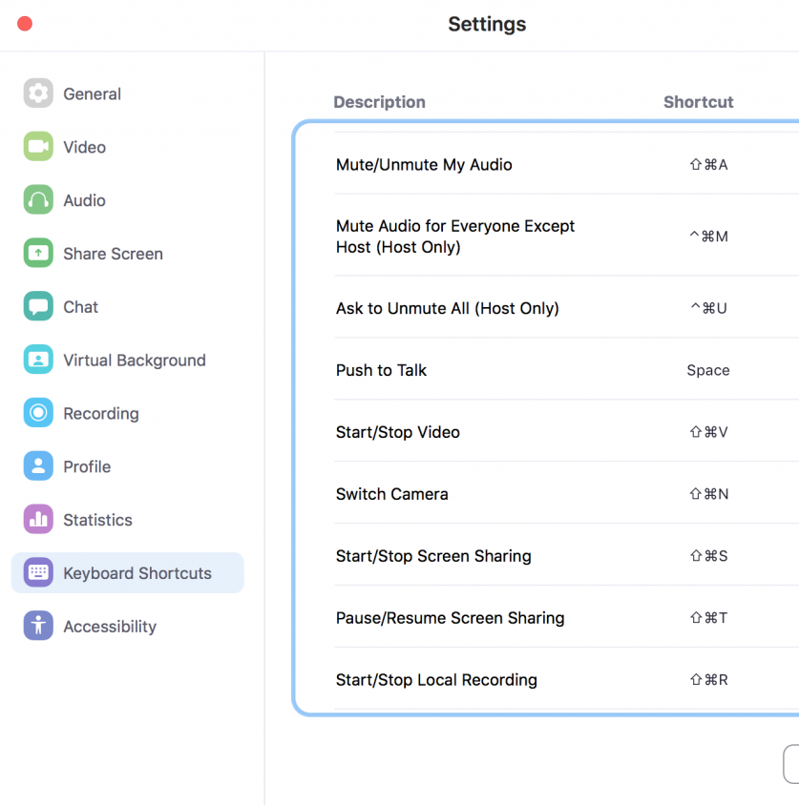
Using Zoom
Raise hand ⌥y
Enable Mic space
Toggle video ⌘⇧V
Toggle chat ⌘⇧H

Slide 10
Using Zoom
Raise hand ⌥y
Enable Mic space
Toggle video ⌘⇧V
Toggle chat ⌘⇧H
Turn your video on,
enable the Mic,
and say
“Hi, my name is _____”

Slide 11
COMS W6113 Topics in Database Research
Eugene Wu
http://w6113.github.io

Slide 12
Database Research
Declarative API to manage data
Defines and enforces clear semantics
Model the data, query, transactions, hardware, etc
Combines PL, systems, theory, optimization, ML to
Maintain data integrity (under failures)
Run queries correctly and quickly
Support application needs

Slide 13
Database Research
Definition of data changing
Records
Graphs
Sensor events
Images & Videos
Documents & PDFs
VR/AR…
Application needs are growing
Hardware, scalability, ML, real-time
Decision making, data exploration, video analytics, etc

Slide 14
This Course
Learn about Database Research
Read classic and modern papers
Work on a research project
Learn how to read papers
Problem selection
Insights and technical contributions
Presentation

Slide 15
Course Topics
Query Execution
Query Optimization
Columnar Stores
Query Compilation
Large-scale Dataflow
Materialized Views
Datalog and Lineage
Physical database optimization
<Your interest here>

Slide 16
Course Topics
We will NOT cover material in 4111, namely
Relational Algebra
SQL
Basics of query execution and optimization
Access methods
Basic design of disk-based database systems

Slide 17
What you will do
Project (65%)
Groups of 2-3
Assignments (15%)
See how pieces of a DB engine fit together
Paper Reviews (10%)
Answer questions for each paper & submit review on wiki
Lots of reading!
Class discussion (10%)

Slide 18
Project
2 Broad Categories
Reproduce and extend
Research project

Slide 19
Reproduce (& Extend)
Reproduce
Read and deeply understand a data management topic
~5 to10+ papers, summarize & compare them
Implement best/combined technique in DataBass/another sys
Benchmark it
& Extend (bonus)
Extend the implementation to make it a bit better
Benchmark to show it is better
Explain when and why the extension is effective

Slide 20
Research Project
Investigate new ideas and solutions
Define hypothesis
Conduct research
Evaluate hypothesis
Writeup and research
Emphasis on hypothesis and evaluation
Translate contributions into testable hypotheses
Evaluation should evaluate hypotheses

Slide 21
Project Overview
Choose from list of projects, or come up with your own
Pick partners, 1 page proposal
Problem you are solving
Hypothesis
Plan of attack, with milestones
Preliminary related work
Demo/Presentation session
Project report

Slide 22
Project Timeline
We are here to help you succeed
Week
02 Release list of projects
04 Submit proposal
Discuss with staff before this stage
07 Submit paper draft
Position relative to state of the art
Play with related tools
11 Check in
14 Showcase
15 Submit paper 8-10 pgs

Slide 23
Programming Assignments
DataBass: Python DB engine ~4K loc
Hands-on experience with query from parsing to execution
A0: add ORDERBY clause
A1: hashjoin, pushdown optimization
A2: selinger join optimization
A3: hashjoin compilation
A4: benchmarking
A5: lineage
A0
A2
A1
SQL
parser
optimizer
interpreter
Compiler + lineage
A3-5

Slide 24
Class Format
Submit paper review before class
Quiz for self assessment
Breakout to discuss quiz/reading
Go over paper ideas
Use chat to ask/answer questions
Optional: sign up to lead discussions
Optional: scribe the discussion, add to course wiki

Slide 25
Reviews
Add to course wiki
Can skip 4 paper reviews (note: 1+ papers per class)
Late submissions not accepted
Questions
What is the problem?
Why does prior work fail to solve it?
Main insight and technical contributions?
Do the evaluations hold up?
What do you wish could be improved?

Slide 26
Reviews
Do not plagiarize
Write original reviews
Do not copy text from papers, online, or other reviews
See http://www.cs.columbia.edu/education/honesty

Slide 27
Presentation
15-20 minutes + discussion
Cover key elements of paper
Find & read related work to provide context
Intuition >> formulae
Create your own examples. Plagiarism rules apply
Lead discussion with questions
Go over presentation with Eugene ahead of time
Send slides to TA 2 days before class, by midnight.

Slide 28
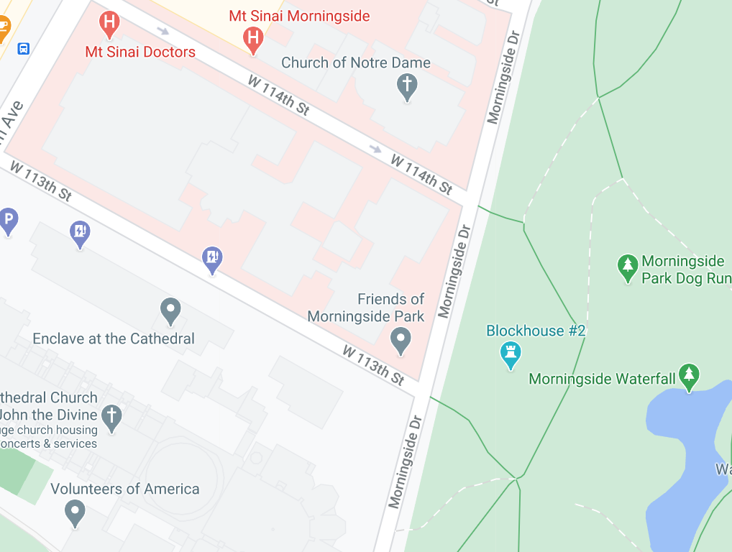
Recitation
Tues 2-3PM EST, an open air space (113th & Morningside)
Attendance is not taken
Purpose
Go over examples
Research advice
Life advice
Stay safe from COVID

Slide 29
Who am I?
Eugene Wu
421 Mudd (DSI space)
ewu@cs.columbia.edu
OH: Tues 3-4PM EST
PhD MIT, 2015
Started @Columbia Fall 2015
Systems for Human Data Interaction

Slide 30
Deka Auliya Akbar
TA for the class
OH: tba

Slide 31
Logistics
w6113.github.io
Class T/Th 11:30 – 1PM, Zoom
Recitation Tues 2-3PM, open air location TBD
Commun. Slack
Reviews Course wiki
Academic Honesty
See http://www.cs.columbia.edu/education/honesty
Ask if unsure, falling behind, etc
Don’t plagiarize. Worse than failing.

Slide 32
Prereqs
Required: 4111 Intro to DB
Declarative languages and data independence
Relational algebra, SQL, relational model
Query optimization and execution
Useful: 4112
Great to have people with different backgrounds
Talk to me if unsure
If graduate student from different area, talk to me

Slide 33
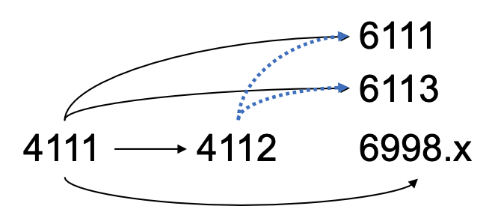
Relationship with other DB classes

Slide 34
Enrollment
~25 students
Doesn’t matter if enrolled or waitlisted
Admission based on quality of
First reviews
Participation in initial classes

Slide 35
Grading
Project 65%
Assignments 15%
Reviews 10%
Participation 10%
No curve, everyone can get A
If project is amazing, automatic A

Slide 36
Breakout: Getting to know each other
Assign one note taker to summarize the breakout to the class
Introduce yourself
Your name, year, department
What is a database you recently used (maybe indirectly)?
Share where you want to travel when you are able to.

